Slide 1
Health-Promoting Behaviors

Slide 2
Agenda
2
Exercise
Accident Prevention
Vaccinations and Screening
Sun Safety Practices
Healthy Diets
Sleep

Slide 3
Exercise
Helps maintain mental and physical health.
Two aspects: increasing exercise and decreasing sedentary behavior
Sedentary behavior: (while awake) sitting, reclining, or lying down
Aerobic exercises: Marked by high intensity, long duration, and the need for endurance (aka, cardio)
Recommendation: 2.5 hours a week of moderate-intensity or 1.25 to 2.5 hours a week of vigorous-intensity aerobic physical activity or a mixture of both.

Slide 4
Exercise
Physical Health Benefits
Mental Health Benefits
Reduces risk of cardiovascular disease, Type 2 diabetes, metabolic syndrome, and some cancers.
Strengthens bones and muscles.
Improves heart health, sleep, and immune system functioning.
Promotes the growth of new neurons in the brain.
Improves mood and general well-being.
Improves sense of self-efficacy.
Improves cognitive functioning.
Has economic benefits.

Slide 5
What characteristics about a person make them more likely to exercise? What characteristics about an environment can promote exercise?

Slide 6
Exercise Interventions
Incorporate principles of self-control.
Increase motivation.
Increase and maintain physical activity.
Promote personal values.
Promote general lifestyle changes.
Relapse prevention techniques: Increase long-term adherence to exercise programs.
Setting personal goals.
Forming explicit implementation expectations.

Slide 7
Accident Prevention
Accidents in the home (such as accidental poisonings and falls) are the most common causes of death and disability among children under age five.
Fall-related accidents are one of the most common cause of death and injuries in older adults.
Vehicle accidents are the leading cause of accidental deaths in the U.S.
Be cognizant of surroundings and other people

Slide 8
Consider your current home. What are some things within your home that could increase the risk of falls or accidents?

Slide 9

Vaccinations
https://www.youtube.com/watch?v=rb7TVW77ZCs

Slide 10
Screening
General recommendation: be aware of what conditions you may be at-risk for, then follow recommended guidelines for screening
Breast cancer
Most common type of cancer in women
Screening: mammogram
Suggested that screenings begin in 40s
Prostate cancer
Most common type of cancer in men
Screening: PSA blood test
Suggested that screenings begin in 40s
Colorectal cancer
Second-leading cause of cancer deaths
Screening: fecal, blood, or DNA test; colonoscopy or sigmoidoscopy
Suggested that screenings begin in 40s

Slide 11
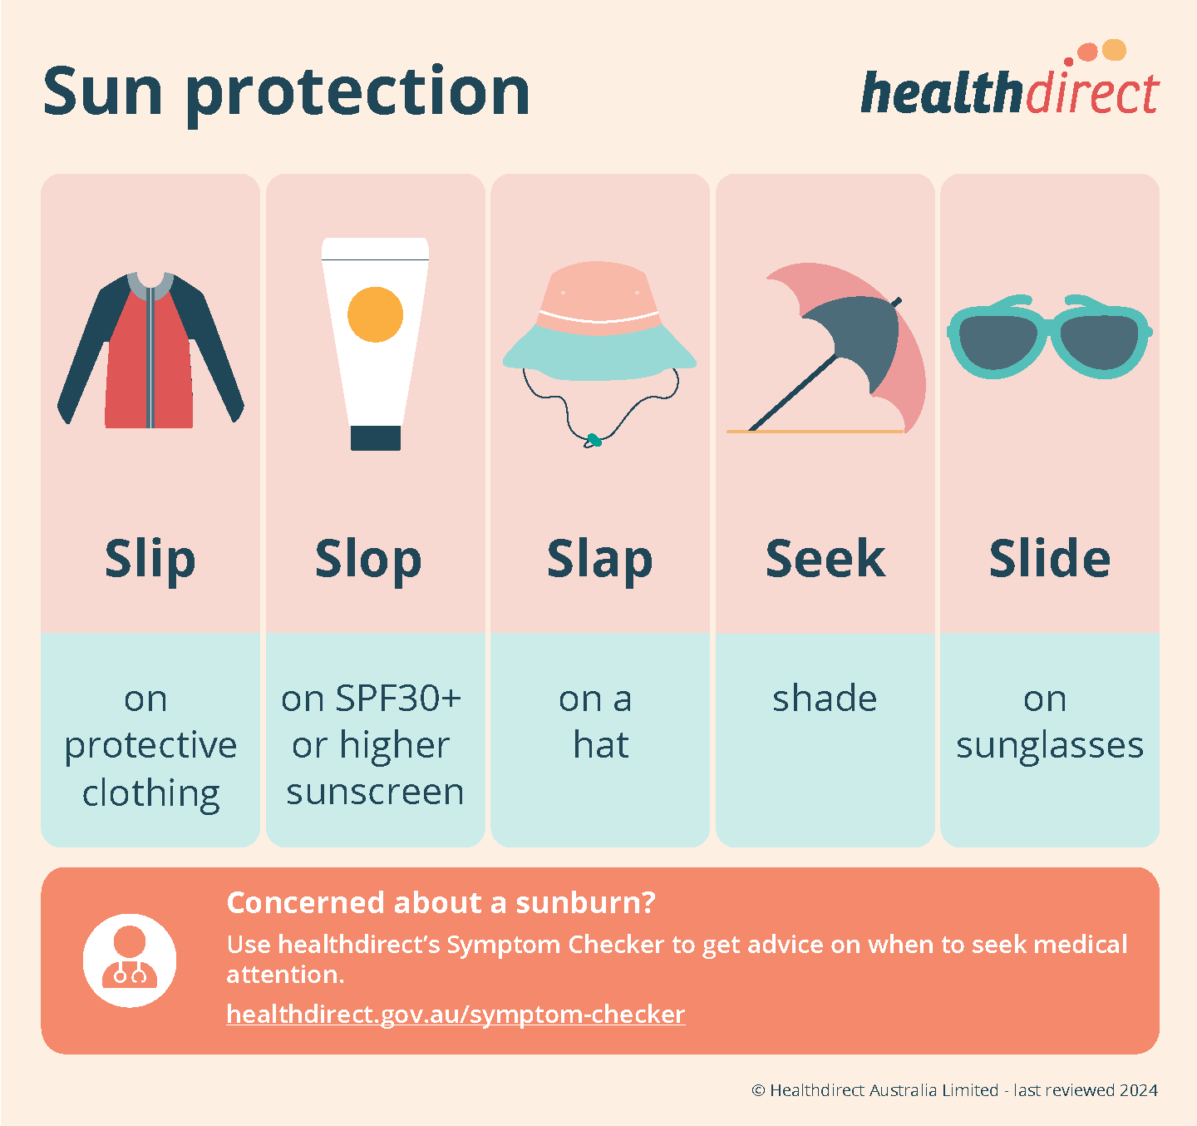
Sun Safety Practices
Skin cancer is not reported/ categorized the same way as other forms of cancer
More people are diagnosed with skin cancer than all other forms of cancer combined (in the U.S.)
According to the Skin Cancer Foundation:
1 in 5 Americans will develop skin cancer by the age of 70.
More than 2 people die of skin cancer in the U.S. every hour.
Having 5 or more sunburns doubles your risk for melanoma.
When detected early, the 5-year survival rate for melanoma is 99 percent.
https://www.skincancer.org/skin-cancer-information/skin-cancer-facts/

Slide 12
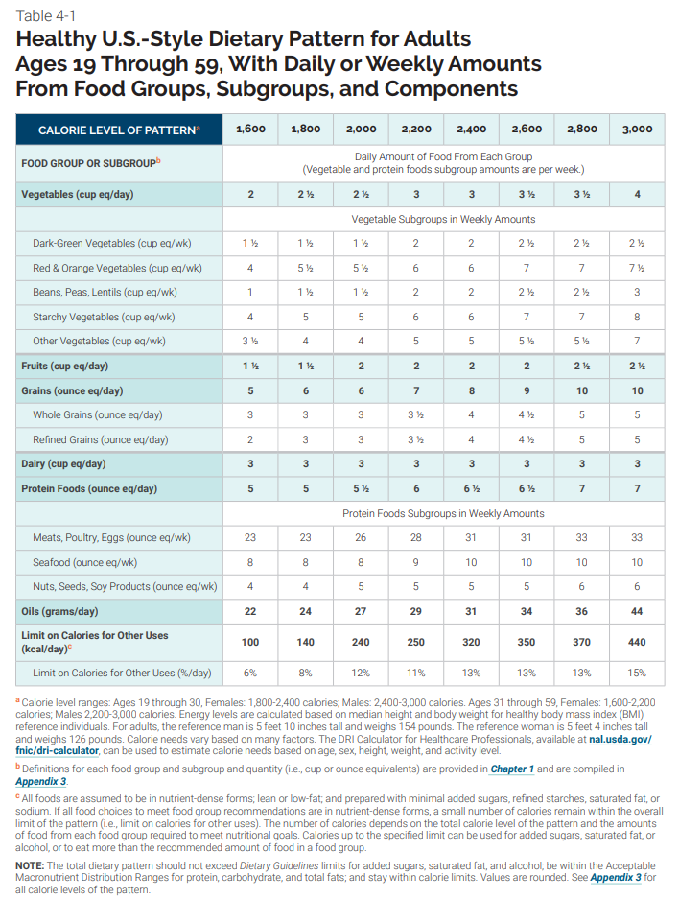
Healthy Diet
Hedonic eating – eating food for pleasure rather than to satisfy hunger
The U.S. Agriculture Department regularly releases recommendations and statistics (see link for more)
When starting a specialized diet to lose weight, talk with a specialist.
Multiple resources available, such as Mindful
https://www.dietaryguidelines.gov/sites/default/files/2021-03/Dietary_Guidelines_for_Americans-2020-2025.pdf

Slide 13
Sleep
7-9 hours per night (for individuals at least 18 years old)
Sleep debt – the cumulative amount of sleep lost over time when an individual does not get enough sleep
Note: your body charges interest!!
Two general categories of sleep: REM (rapid eye movement) and NREM (non-REM)
NREM sleep is further categorized by three stages
REM sleep is when dreaming occurs
NREM sleep is crucial for multiple life functions, including:
Restoring energy
Strengthening the immune system
Promoting release of the growth hormone
Similarly, REM sleep is important for many aspects of life, but especially:
Solving problems
Consolidating memories and knowledge
Sleep can be categorized by types of brain waves

Slide 14
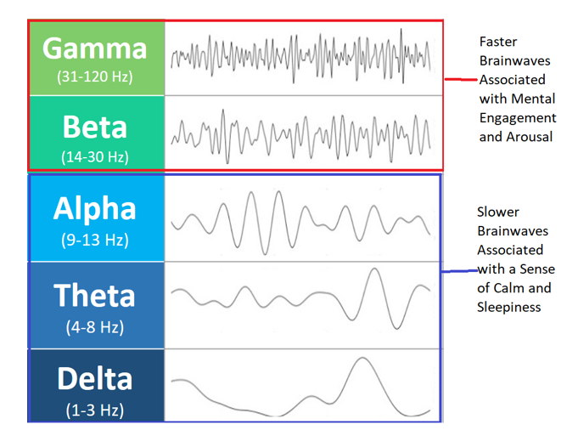
Types of Brain Waves
Amplitude: the height of a wave; determines loudness
Frequency: the distance between waves; determines pitch

Slide 15
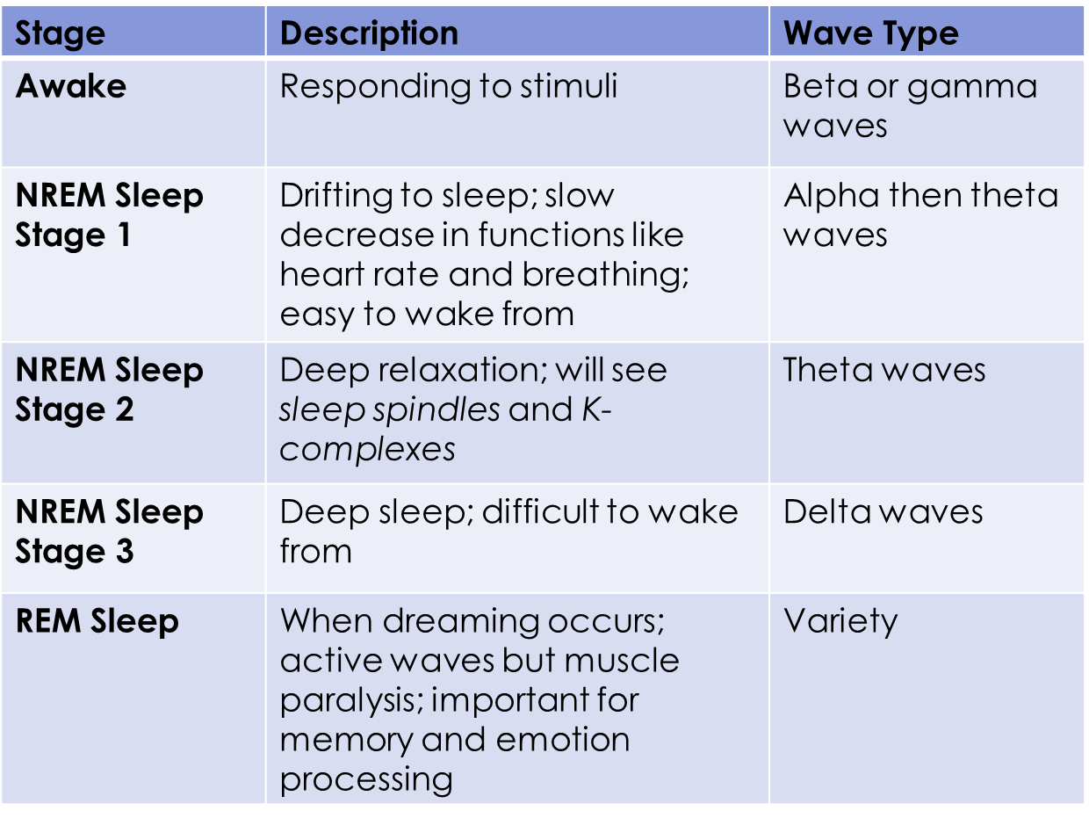
Stages of Sleep

Slide 16
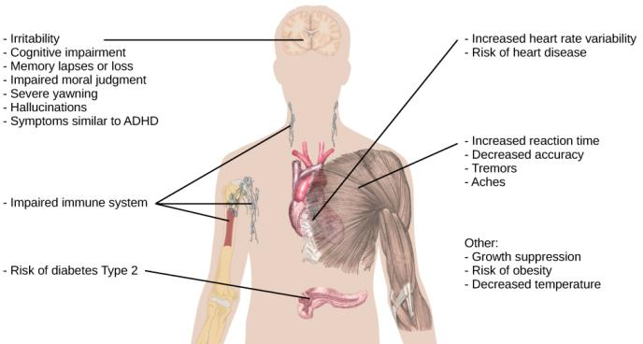
Ramifications of Poor Sleep

Slide 17
Next time on PSY 440…
Before Next Class:
In Our Next Class:
Complete Friday’s assignment (Week 3- Class Activity #2)
Due TONIGHT at 11:59pm
Complete today’s activity (the journal prompt)
Due Wednesday at 11:59pm
Research towards your BCP
Class activity!

